Slide 1


Slide 2

MISSION STATEMENT
To provide reliable, timely and safe cab services by using a Global Positioning System (GPS) along with computer aided dispatch

Slide 3
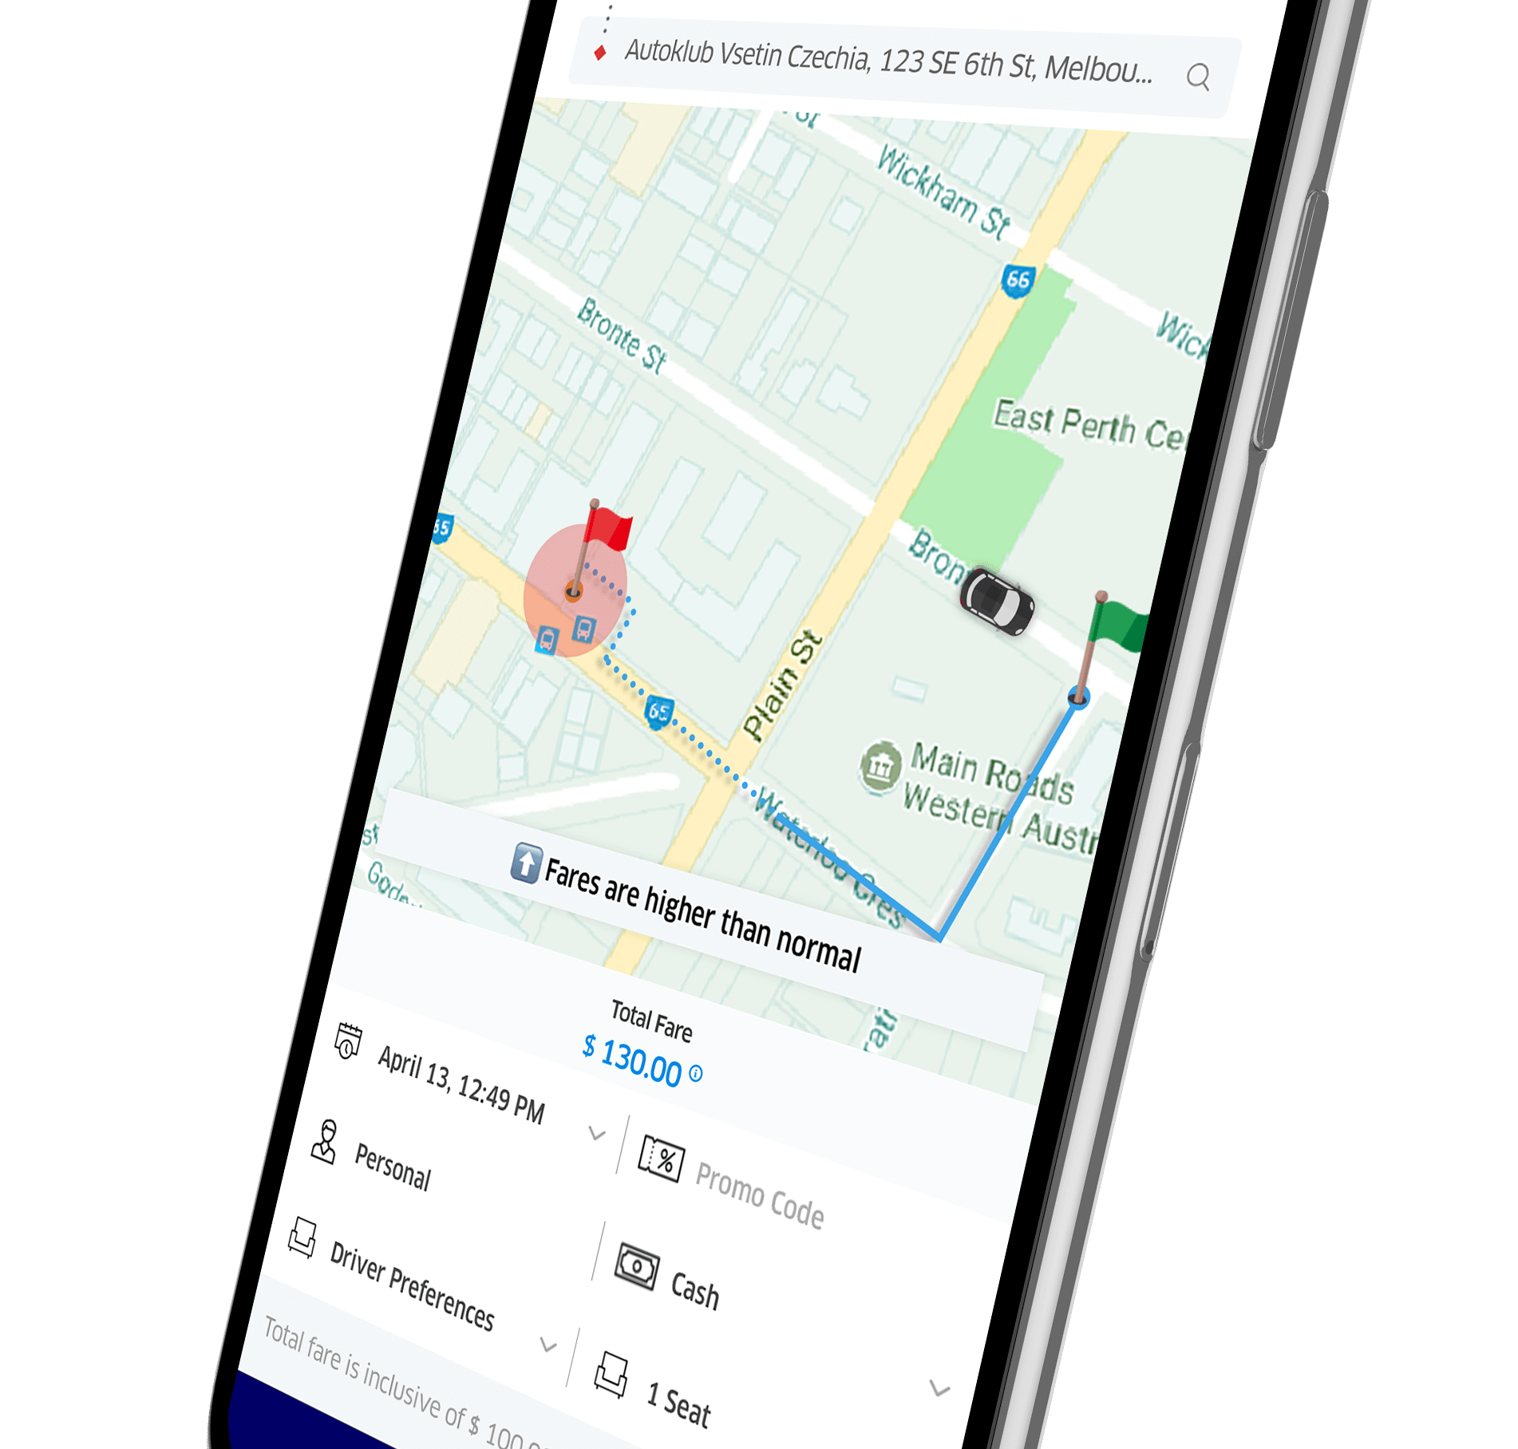
Functionality
Client
No Registration is needed
Drivers
First downloads the pick me up app
Has access to request for a taxi
Can only register via admin once all particulars have been met
Can change status accordingly to offline, busy & available

Slide 4
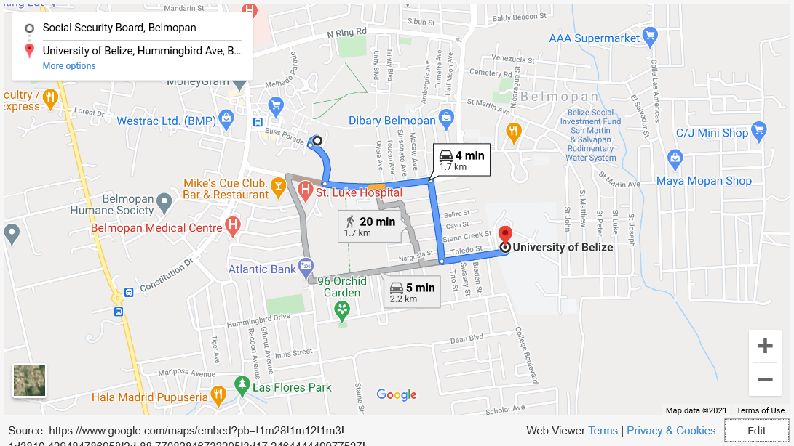

Slide 5


Future Functions
A driver can only claim one pickup at a time
Flash Modifiers
Rating system
Members
Pablo Cawich
Austin Shaw
Osmer Escarraga
Hector Castellanos
Michael Sanchez

